Slide 1

AUTOMATE WHATSAPP USING APPIUM

Slide 2

Objective:
To test the Whatsapp application using Appium with test cases such as login page, messages, blocked contacts etc.

Slide 3

Abstract:
The most used and efficient method of communication in recent times is an application called WhatsApp.
To automate the Whatsapp chat analyzer.
To automate the Whatsapp application which is social networking service, photo-sharing and video-sharing that enables its users to share pictures, videos, documents etc.
And also share them on a variety of social media networking platforms, such as Facebook, Twitter, Tumbler etc.

Slide 4

Proposed System :
Software that are to be installed are :
Android studio :Visualization.
IntelliJ: To write and run the code.
Appium: To automate the application.
Tests for Whatsapp application are :
Verify mobile number
Verification code
Message duration
Privacy setting
Hide status update
Read message notification(Blue tick)
Verify that on successful registration
Blocked contacts
Profile.

Slide 5
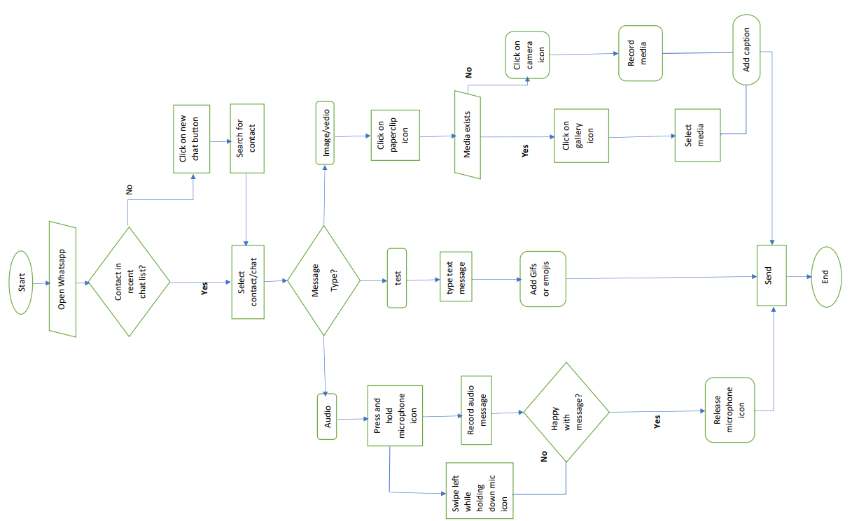
Data Flow Diagram:

Slide 6
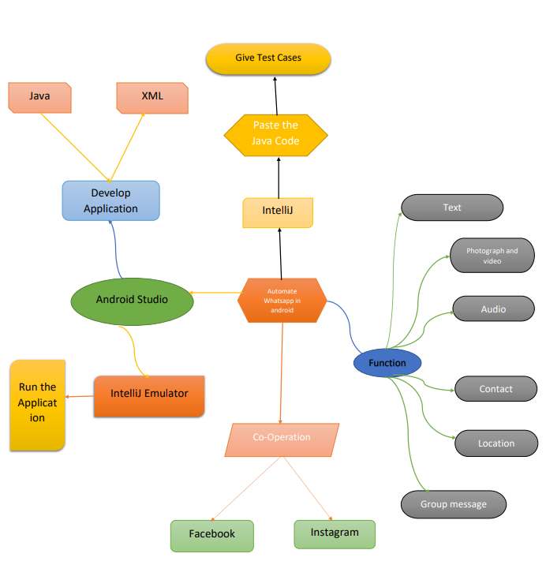
Concept map:

Slide 7



APP TOOLS:
Appium
Android studio
IntelliJ

Slide 8
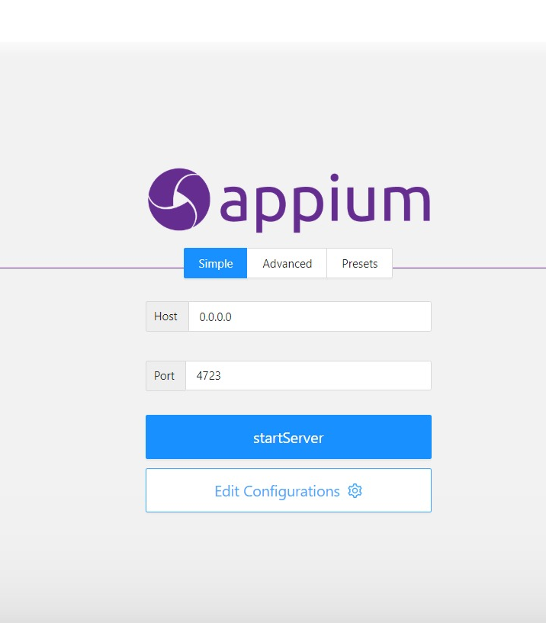
Appium Installation:

Slide 9
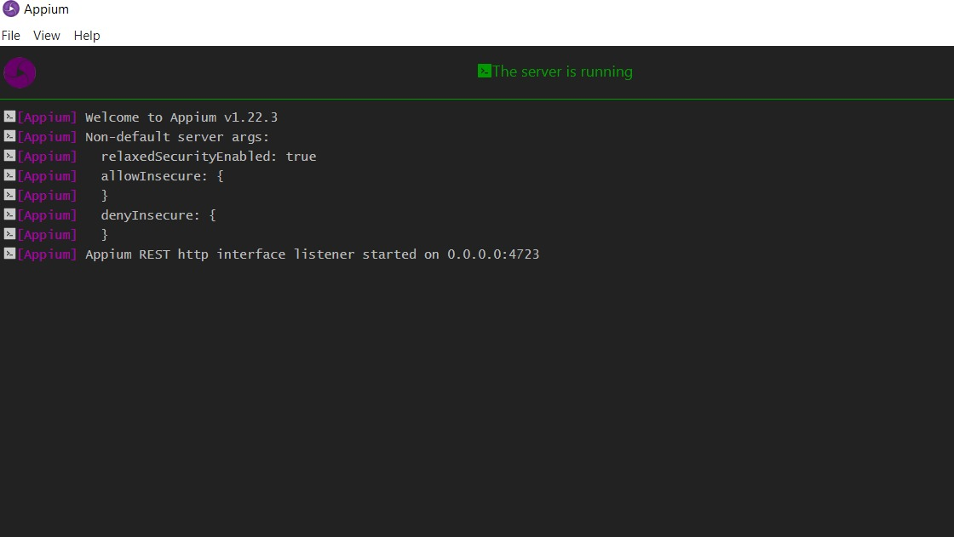
Appium Server

Slide 10
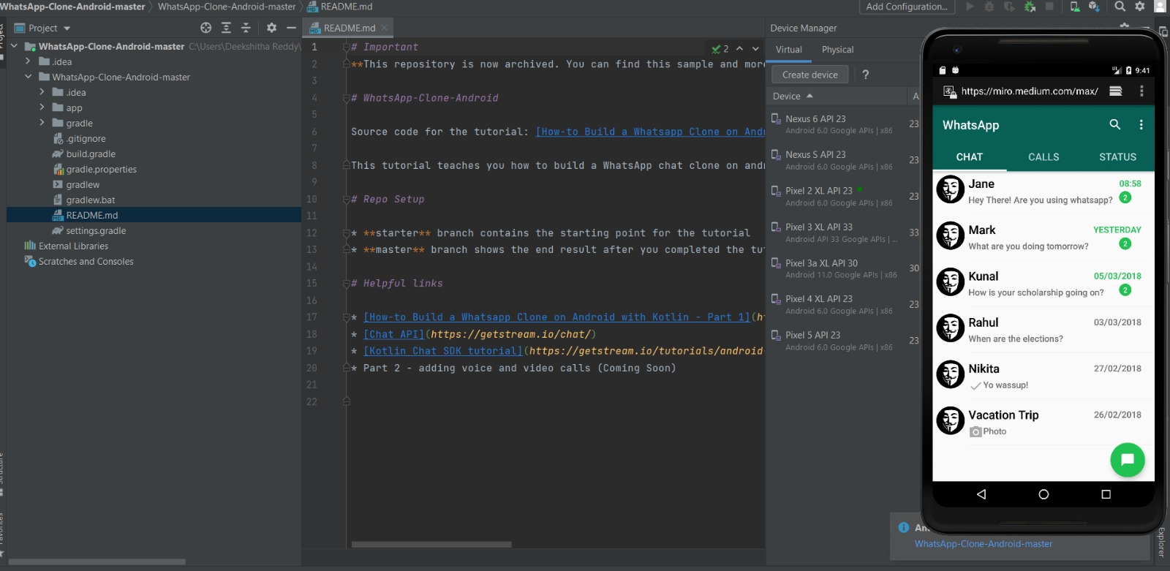
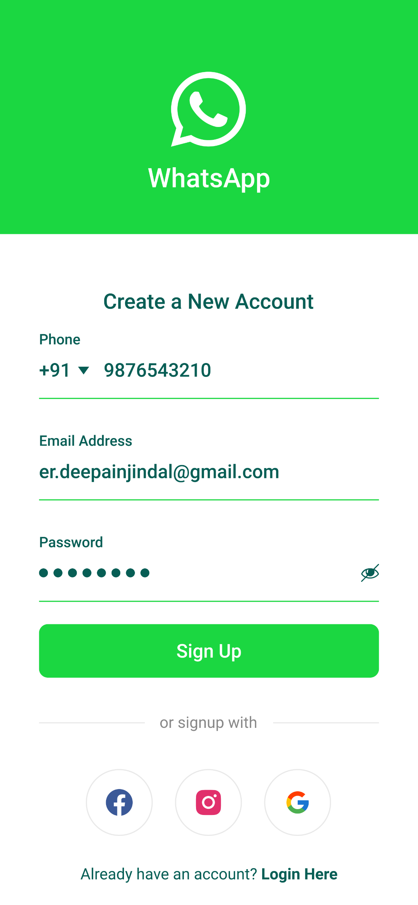
Android Studio

Slide 11
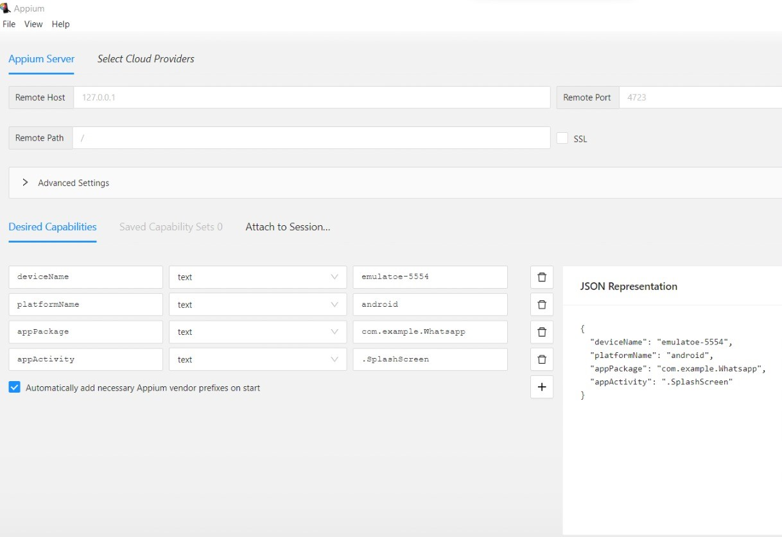
Implementation Of Testing:

Slide 12
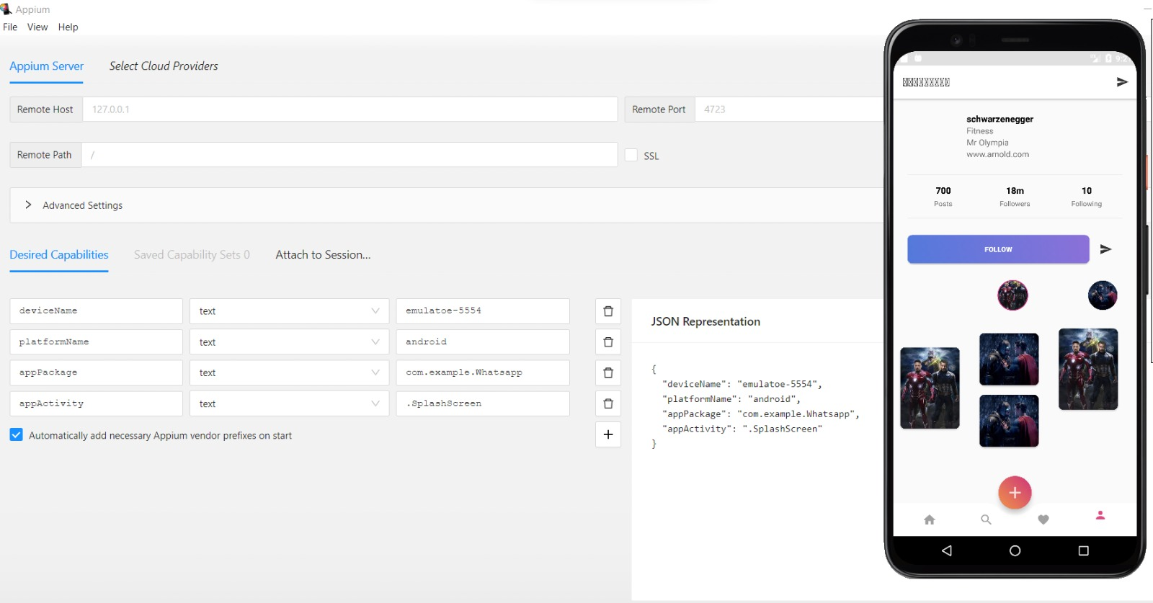

Testing Outputs:

Slide 13
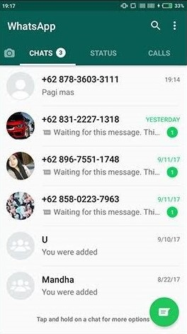
Testing Outputs:

Slide 14
TEXT CASES | Text types- Positive/Negative
Enter valid mobile number | Positive
Enter invalid mobile number | X Negative
Check whether the user gets verification code | Positive
Check the maximum number of incorrect attempts allowed while filling out the verification code | Positive
Verify the whether the all contacts are imported to the Whatsapp | Positive
Verify the user can set two profile pictures at a time | X Negative
Verify whether user can update status | Positive
Check whether user can type messages for more than one contact simultaniously | X Negative
Check whether status can viewed by everyone | X Negative
Verify that the user can check messages delivered | Positive
Check if the user can share more than 30 images at a time | X Negative
Check if messages can be received from the blocked contacts | X Negative
Check if two Whatsapp groups can be combined | positive
Check whether user can share different types of documents/pdf/files. | positive
Text scenarios:

Slide 15
Conclusion:
Thus the goal to test the Whatsapp application is done successfully using Appium software with the help of test senarios

Slide 16

THANK YOU

